Slide 1
Chicago Casino: Where to build?

Slide 2
Business Problem
Problem:
The City of Chicago has had many problems keeping up with expenditures, particularly an ever growing pension deficit. They are constantly seeking new ways to increase tax revenue to support the budget, however too much pressure has caused people to leave the state. One proposal to increase tax revenues without necessarily increasing the burden on residents is to allow one or more casinos to be opened within city limits. This would generate tax revenues from both residents and non-residents and may attract more visitors.
A Proposed Solution:
Many questions have arisen about where a casino should be placed so as to be accessible, while not adversely impacting other venues in the area. The city would like to find an ideal location that will help the area surrounding the casino to grow. My task is to explore where a casino could be placed and determine where it may be the most successful.
Who is interested?
City of Chicago officials
Residents of Cook County who are most impacted by taxes

Slide 3
Data used
Foursquare venue data was used to assess the nearby amenities that would allow for success of the casino in a given neighborhood
City of Chicago Survey Results were used to create limiting criteria based on actual responses for resident concerns and priorities
Neighborhood Data was used to determine appropriate placement and access for visitors

Slide 4
Sources
https://chicago-zone.blogspot.com/2014/03/chicago-zip-code-map-locate-chicago.html
https://en.wikipedia.org/wiki/Community_areas_in_Chicago
https://data.cityofchicago.org/Facilities-Geographic-Boundaries/Chicago-Zip-Code-and-Neighborhood-Map/mapn-ahfc
https://www.chicago.gov/city/en/sites/chicago-casino/home/survey.html

Slide 5
Methodology
To prepare the analysis I compiled a list of Chicago neighborhoods and zip codes, using those zip codes to obtain latitude and longitude coordinates.
I used a filtering technique based on the survey results to limit the venue selection to only those that fit the highest priorities noted which included: Entertainment, Hotels, Restaurants, Food and Nightlife Spots in the area

Slide 6
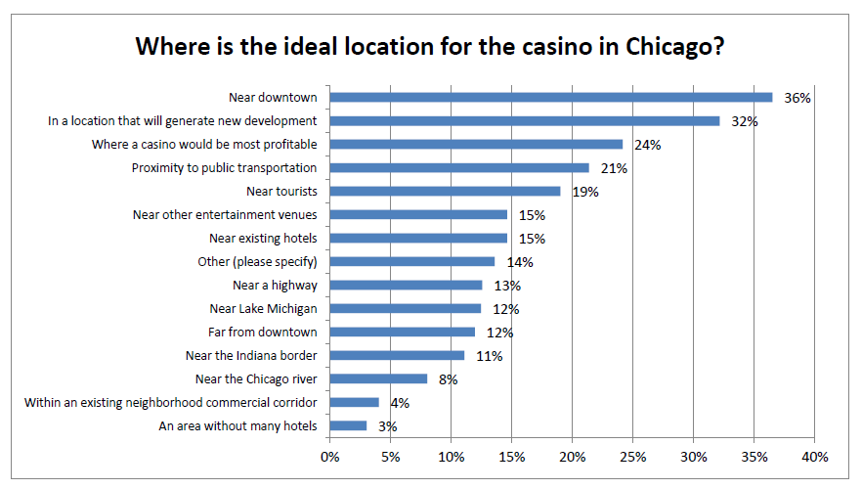
https://www.chicago.gov/city/en/sites/chicago-casino/home/survey.html

Slide 7
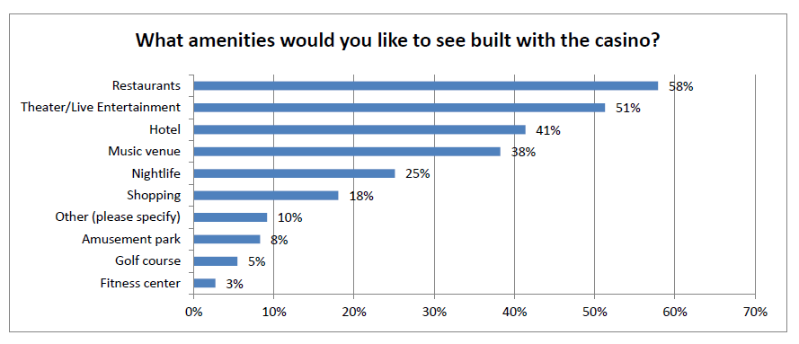
https://www.chicago.gov/city/en/sites/chicago-casino/home/survey.html

Slide 8
Methodology - Clustering
After the initial screening techniques I applied k-means clustering to determine the arrangement of neighborhoods that had the most existing amenities to support establishing a casino.

Slide 9
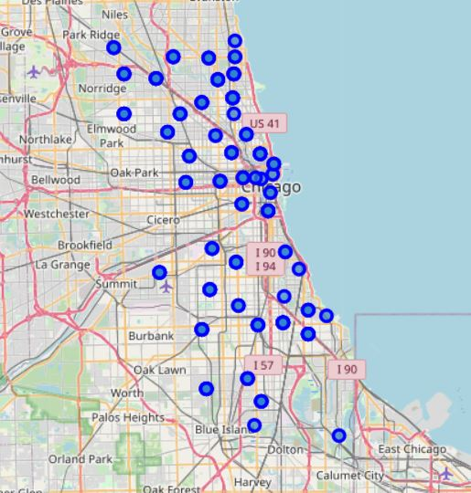
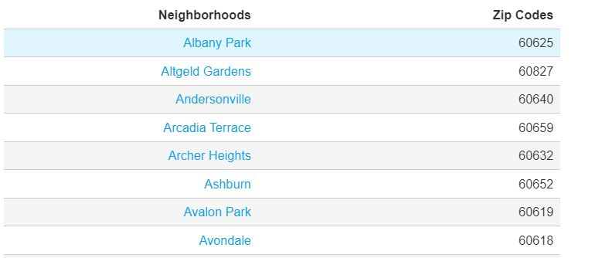
Initial Data
Initial Data for Chicago neighborhoods scraped from html

Slide 10
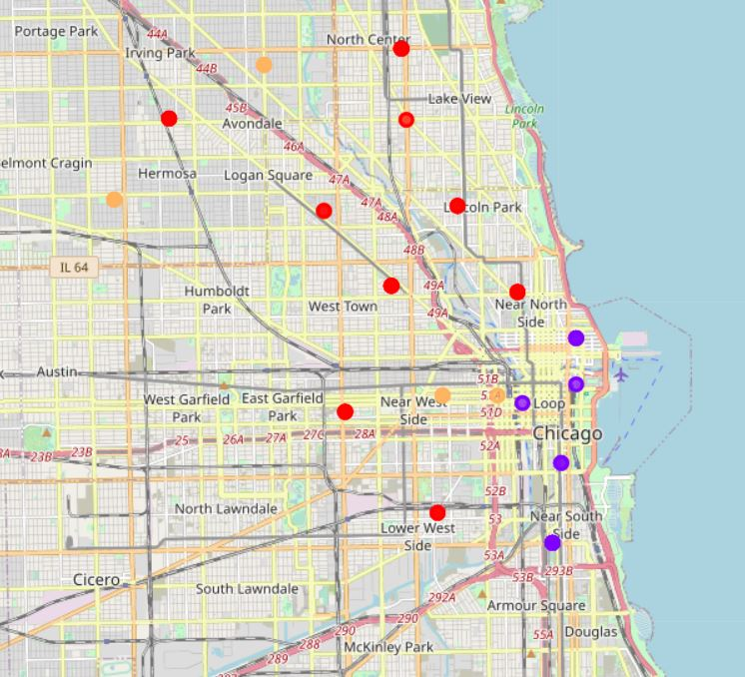
Cluster Results
Refined cluster results

Slide 11
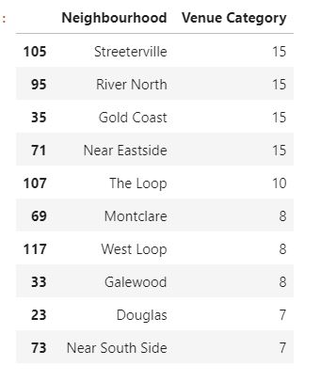
Results
Based on the stated priorities of certain nearby amenities to support the attractiveness, I reduced the number of neighborhoods down and ranked them according to the number of supporting characteristics.

Slide 12
Discussion
Discussion section where you discuss any observations you noted and any recommendations you can make based on the results.
As a resident familiar with the area, I confirm the clustering results are in line with the stated objectives.
The results indicate neighborhoods that:
Have certain sought amenities that complement a casino including hotels, restaurants and music venues
Are in close proximity to “downtown”
Are easily accessible via a variety of transportation methods

Slide 13
Conclusion
Based on the results, building a casino in the near north or near west neighborhoods would be best suited because they have the most available resources including transportation.
Building in these areas would provide the greatest chance of successful uptake and growth for the casino and support the surrounding areas.
Provided the casino does not compete directly with surrounding businesses considered amenities this project would support increased tax dollars and attract additional visitors to surrounding amenities.

